Slide 1
Abstract
In electronics, a clipper is a device designed to prevent the output of a circuit from exceeding a predetermined voltage level without distorting the remaining part of the applied waveform. Whereas, a clamper is an electronic circuit that fixes either the positive or the negative peak excursions of a signal to a defined value by shifting its DC value.

Slide 2
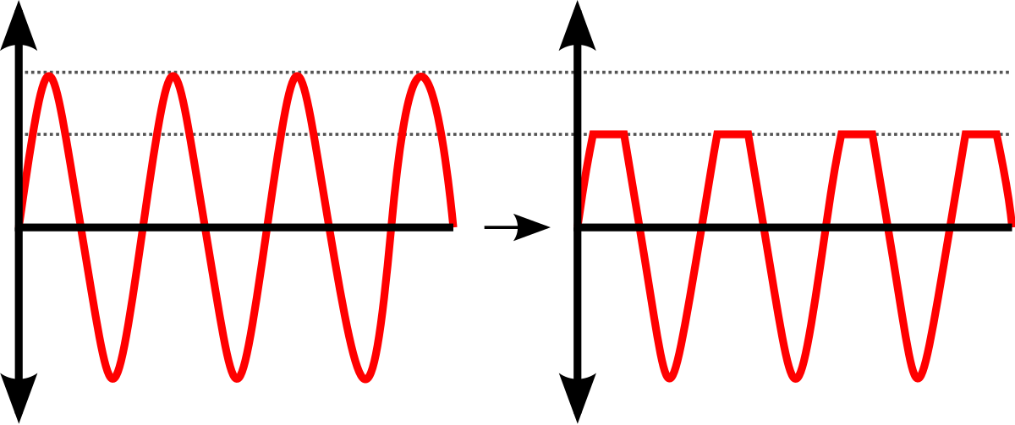
Clipper Circuits
Clipper circuits clip off or remove portions of an input signal voltages above or below certain limits without causing any distortion to the remaining part of the waveform. Clippers are basically wave shaping circuits that control the shape of an output waveform. It consists of linear and non-linear elements but does not contain energy-storing elements. The circuits limit the range of the output signal. The level at which the signal is clipped can be adjusted by adding a dc bias voltage in series with the diode.

Slide 3
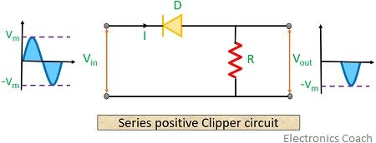
Classification of Clipper circuits
1. Series positive Clipper circuit:
The positive half of the input waveform reverse biases the diode. Thus it acts as an open switch and all the applied input voltage drops across the diode. Resultantly providing no output voltage for the positive half of the input waveform. From the circuit, we can say that during the positive half cycle of the input waveform, the diode becomes forward biased, thus ensuring a closed circuit. Due to this current appears across the resistor of the circuit.

Slide 4
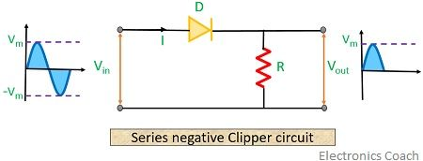
Classification of Clipper circuits:
2. Series negative clipper circuit:
In the negative half of the input waveform, the diode is in the forward-biased state. Thus it acts as a closed switch causing no voltage drop at the diode. From the circuit, we can say that the negative half of the input waveform, the diode now becomes reverse biased acting as an open switch. This causes no current to flow through the circuit. Resultantly providing no output for the negative half of the input waveform.

Slide 5
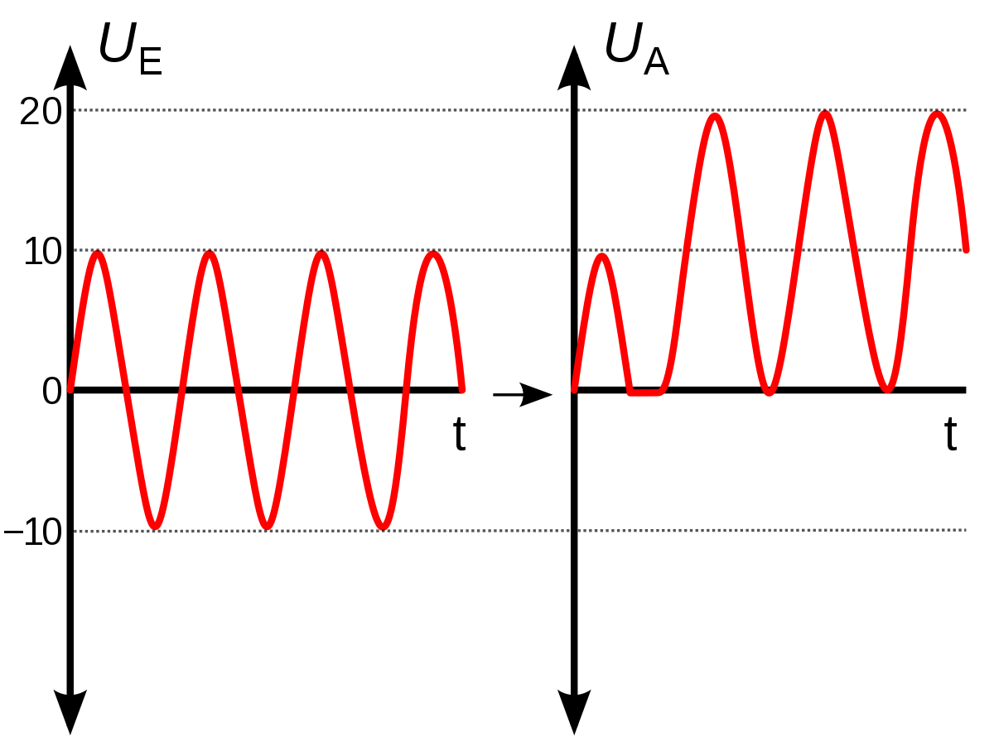
Clamper Circuits:
The Clamper circuit adds the DC element which may be positive or negative to the AC input signal. It pushes the signal towards the positive or the negative side. The positive and negative peaks of the signals can be placed at desired levels using the clamping circuits. As the DC level gets shifted, a clamper circuit is called a Level Shifter.

Slide 6
Types of Clampers:
Positive Clamper
Positive clamper with positive Vr
Positive clamper with negative Vr
Negative Clamper
Negative clamper with positive Vr
Negative clamper with negative Vr

Slide 7
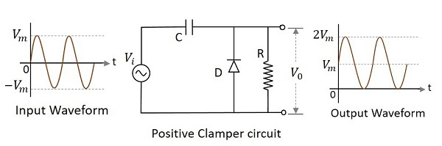
Positive Clamper Circuit:
A Clamping circuit restores the DC level. When a negative peak of the signal is raised above the zero level, then the signal is said to be positively clamped. A Positive Clamper circuit is one that consists of a diode, a resistor, and a capacitor and that shifts the output signal to the positive portion of the input signal. The figure below explains the construction of a positive clamper circuit.

Slide 8
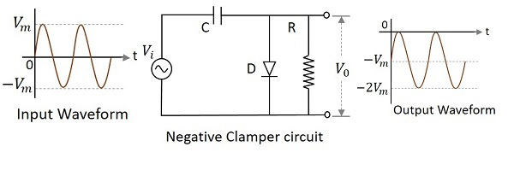
Negative Clamper:
A Negative Clamper circuit is one that consists of a diode, a resistor, and a capacitor and that shifts the output signal to the negative portion of the input signal. The figure below explains the construction of a negative clamper circuit.

Slide 9
SERIES POSITIVE CLIPPER CIRCUIT WITH BIAS
Clipper circuits are basically termed as protection devices. There is a need to clip or remove a certain portion of positive half of input waveform, series positive clippers with biasing are needed.
Positively biased circuit
Negatively biased circuit

Slide 10
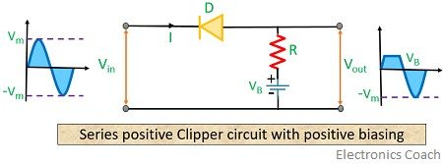
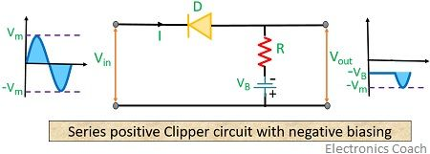
Positively and Negatively biased circuit
In Positive circuit shown above, we can see that the diode is in forward bias condition concerning the battery.
In Negative circuit, the diode is reverse bias due to both supply voltage and battery potential.

Slide 11
SERIES negative CLIPPER CIRCUIT WITH BIAS
There is a need to clip or remove a certain portion of the negative half of the input waveform, then series negative clipper circuits with biasing is needed.
Positively biased circuit
Negatively biased circuit

Slide 12
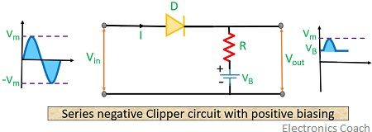
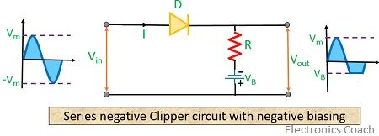
positively and negatively biased circuit
In positive circuit, we have noticed that for the positive half of input waveform, the diode becomes forward bias.
For the positive half of the input cycle, supply voltage and battery potential both cause the diode to be in forward biased condition.

Slide 13
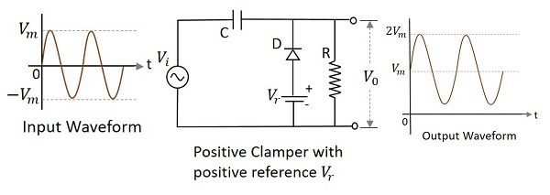
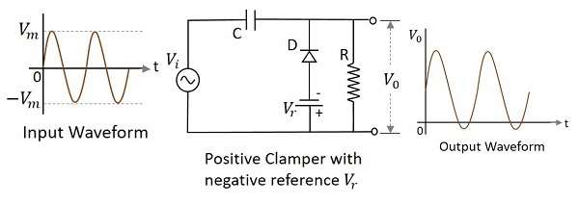
Positive Clamper with Positive and negative V_{r}
A Positive clamper circuit if biased with some positive reference voltage, that voltage will be added to the output to raise the clamped level.
A Positive clamper circuit if biased with some negative reference voltage, that voltage will be added to the output to raise the clamped level.

Slide 14
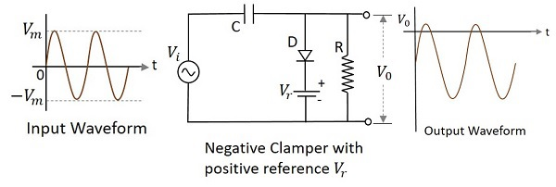
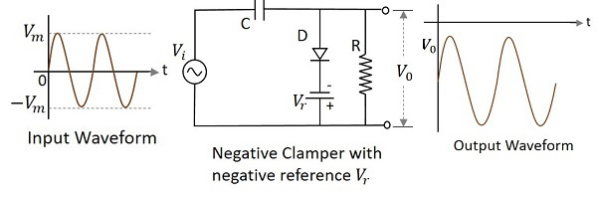
Negative clamper with positive and Negative V_{r}
A Negative clamper circuit if biased with some positive reference voltage, that voltage will be added to the output to raise the clamped level.
A Negative clamper circuit if biased with some negative reference voltage, that voltage will be added to the output to raise the clamped level.

Slide 15
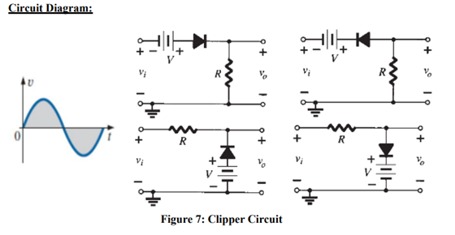
Circuit Diagram (clipper circuit)

Slide 16
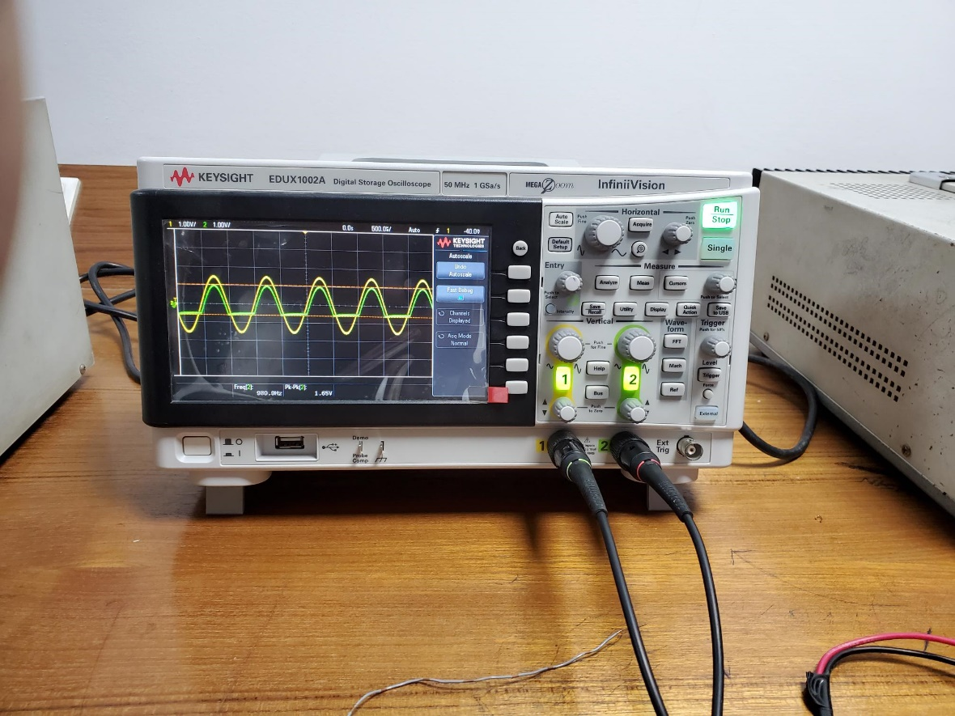
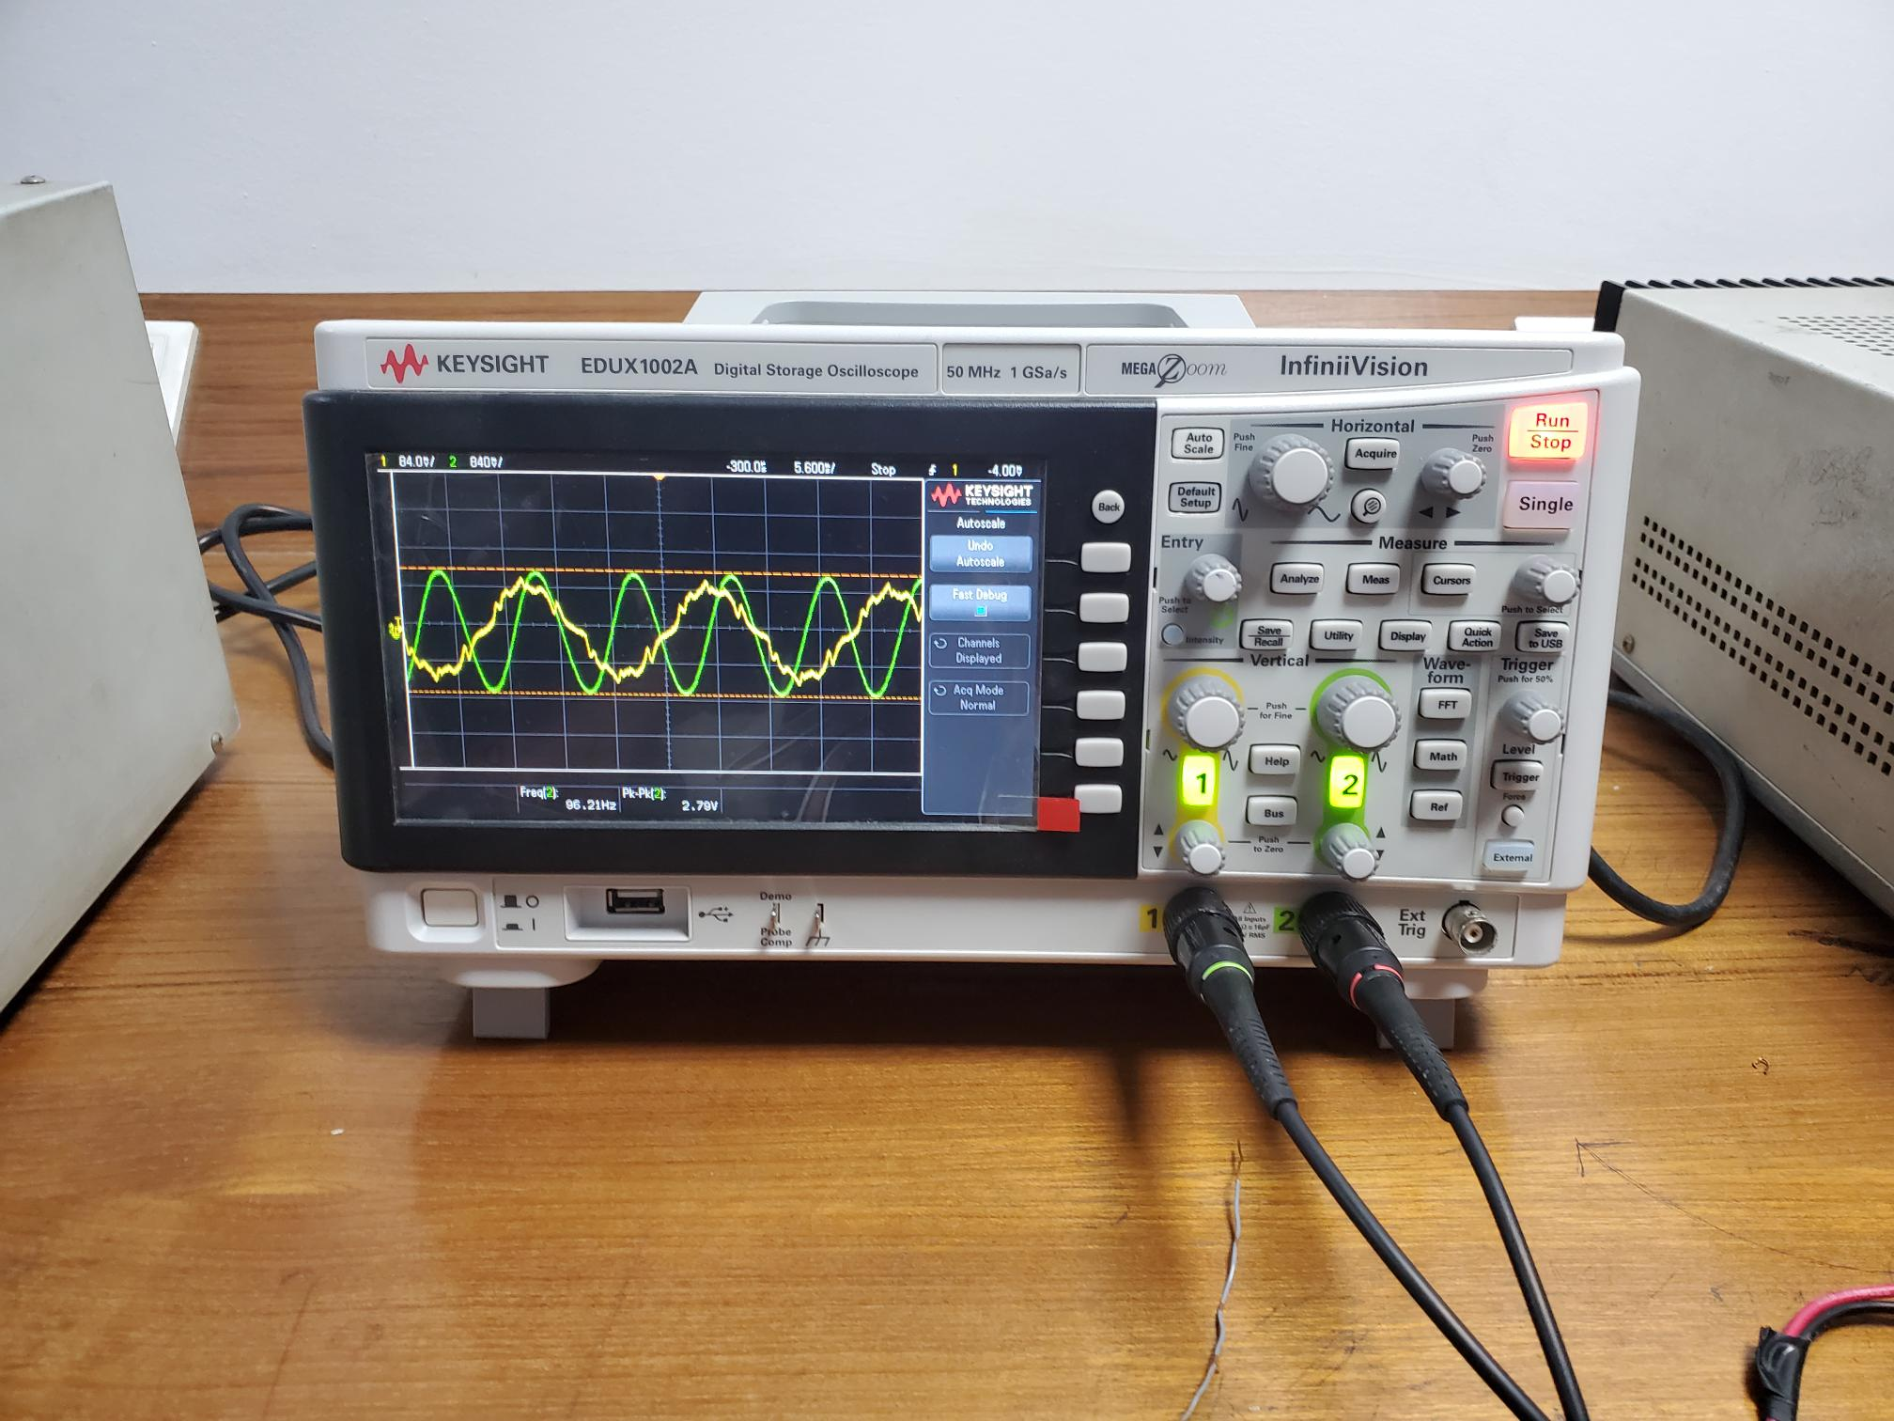
Clipper circuit waveshape

Slide 17
Discussion
A clamping circuit is used to place either the positive or negative peak of a signal at a desired level.
A clamper circuit will bind the upper or lower extreme of a waveform to a fixed DC voltage level.
Clampers can be constructed in both positive and negative polarities.
Some internal resistance and some diode voltages are contained by every diode.
The circuits had been built during the experiment procedure according to the circuit diagram.

Slide 18
Thank you

